Slide 1

MedNET
Creative Brief
Created by:
Michael Wilson Coding Student

Slide 2

Contents:
Vision............................3 NEED.............................4 Target Platform.............4 Target Demographic......5 Target Audience............6 Competitive Analysis....7 ….....8 ….....9 Style Guide.................10 Features....................11 Wireframes...............12 Application Flow.......13 Development Timeline...14 About the Developer......15

Slide 3

The Vision
“We want to be the application for patients all over the world of all ages, to help speed up their doctor visits.”

Slide 4

The Need!
After doing some research it has come to my attention that there are just a few good apps in the Google Play store that allow you to enter your medical history. Now that could be for a surgery or just a routine doctors visit. Doctors need accurate health information to properly treat you, without endangering your well being.
Target Platform
MedNET will be exclusively developed for Android devices. As of 2014, Android devices held an 81.5% market share over other devices.
Notes:
Make changes to the need! There are apps on the play store

Slide 5


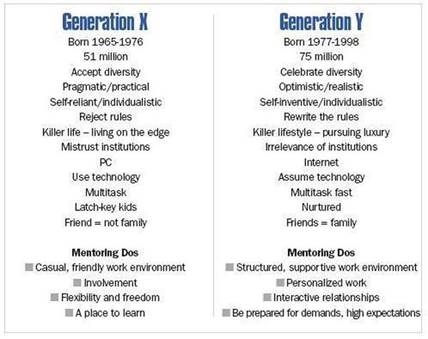

Target Demographics
MedNet will target all people no matter of age, race, or sex. No matter how sick a person is or how healthy a person is sooner than later they will need to go see the doctor and why not have all your medical information with you at all times, in case of an emergency!! MedNet never leave home without it!!!

Slide 6



Target Audience
MEDNet's target audience will be everybody. No matter what age you are or what sex you are, chances are you are going to get sick at some point in your life. Why waste the paper and ink in your printer to print out your medical history or insurance information and surgeries that you have had, when you can have all that information with you at all times.

Slide 7
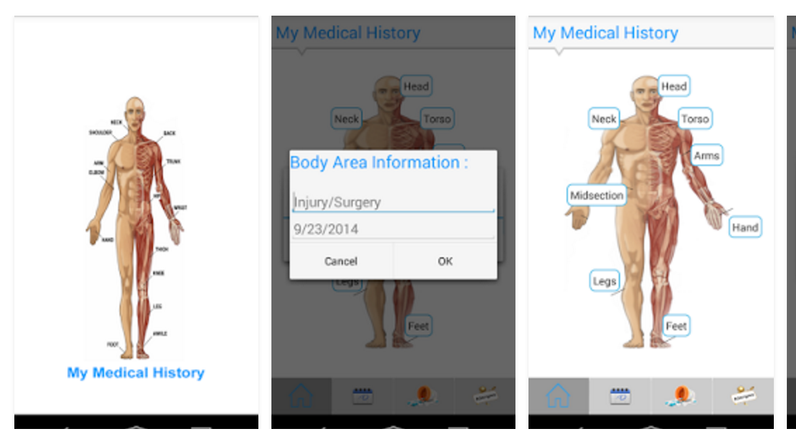
MyMedicalHistory Competitive Analysis
Strengths
You can add doctor’s appointments to the app.
Weaknesses
Hasn’t been updated since 2014, looks are outdated.
Opportunities
Make some updates to the look, for a fresh look.
Threats
MedNET is newer and will be updated accordingly

Slide 8
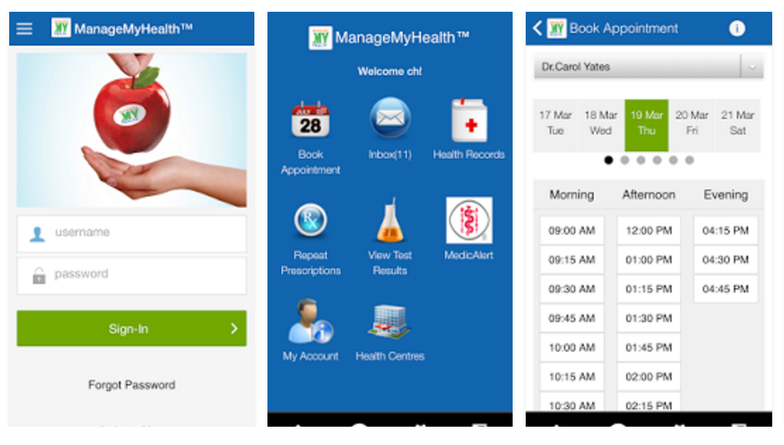
ManageMyHealth Competitive Analysis
Strengths
Request repeat prescriptions, view lab results, secure communication with your health professional
Weaknesses
Lags to much, and problems with the UI.
Opportunities
Clean up the UI, work on the lagging problem.
Threats
UI problems may be its downfall.
Notes:
Request repeat prescriptions
View lab results
Secure communication with your health professional
Manage your health goals, set up tasks and track results

Slide 9
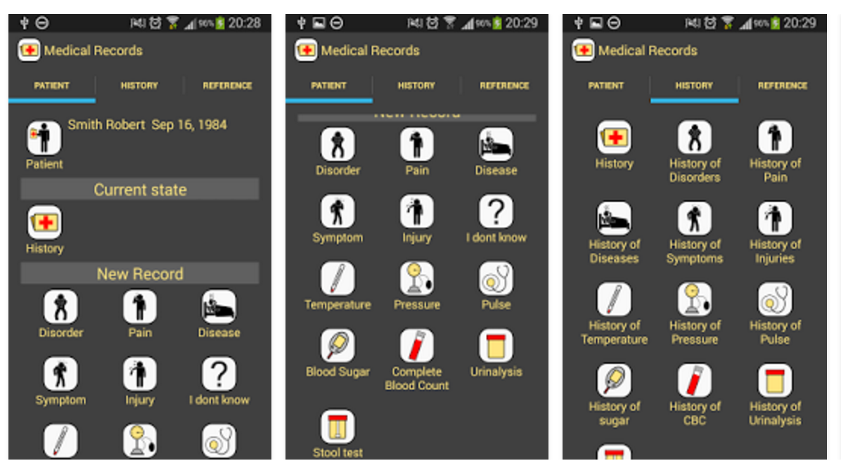
Medical Records(Free) Competitive Analysis
Strengths
comprehensive medical reference written in plain language.
Weaknesses
Navigation on the app isn’t the easiest.
Opportunities
Clean up the navigating issues with the app.
Threats
Apps with easier navigation and cleaner UI’s
Notes:
comprehensive medical reference written in plain language. The directory contains several thousand articles and section by category: disease, disorders, injuries, symptoms and pain.

Slide 10



Style Guide
#03588C
#024873
#03658C
#049DBF
#04ADBF
App Icon
Logo

Slide 11
Features of MedNET
Core
Store Medical information
Multiple Logins
Never be without your medical history
Supporting
Supplemental
Notes:
Finish the features

Slide 12
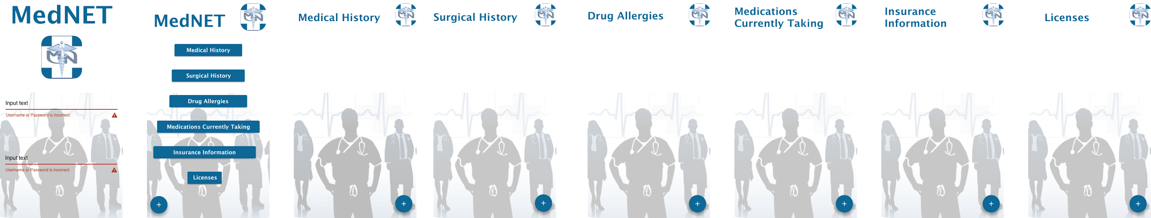
WireFrames

Slide 13
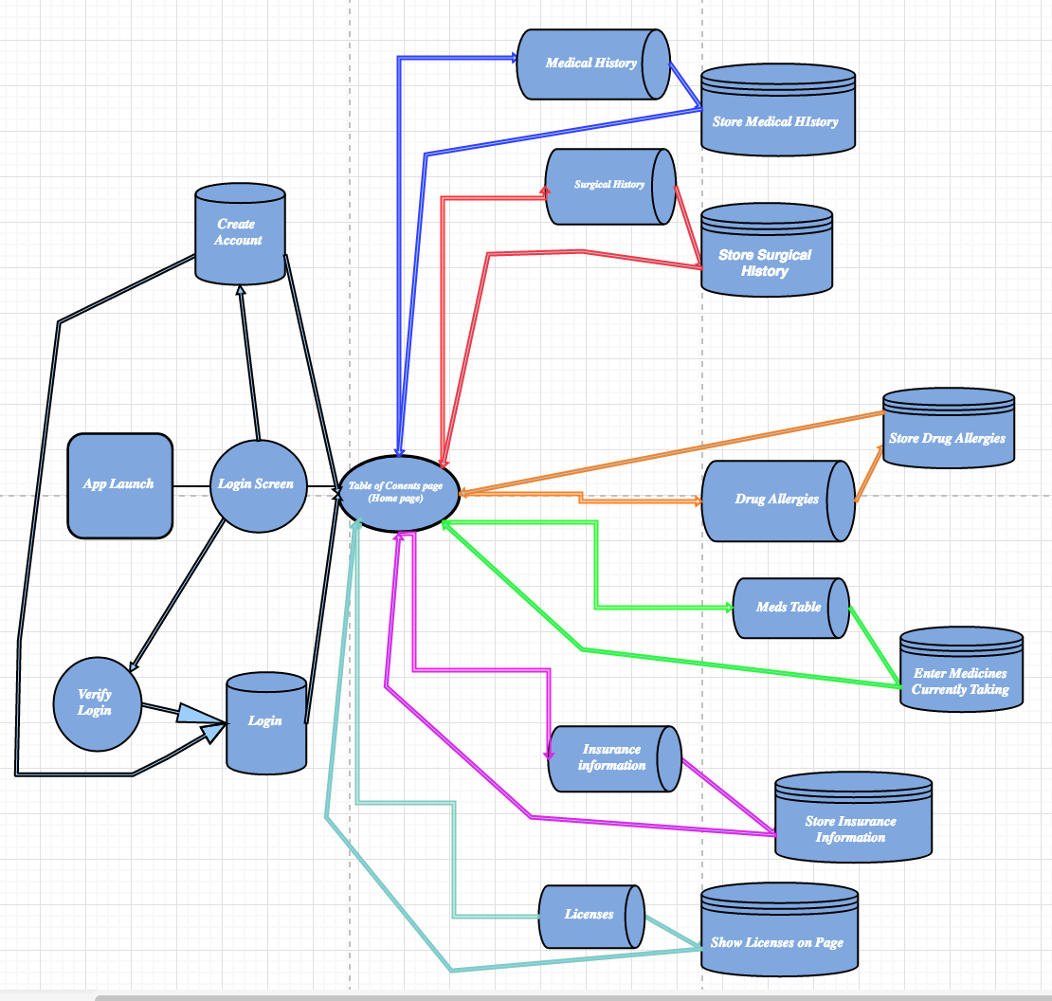
Application Flow

Slide 14
Development Timeline
Week 1
Week
2
Week
3
Week
4
Week
5
Week
7
Week
9
Week
11
Week
12
Learn Java
Learn Java
Learn
Android
Learn
Android
Learn
Android
Start
Coding App
Finish up app
Present app
Start App
ideas

Slide 15
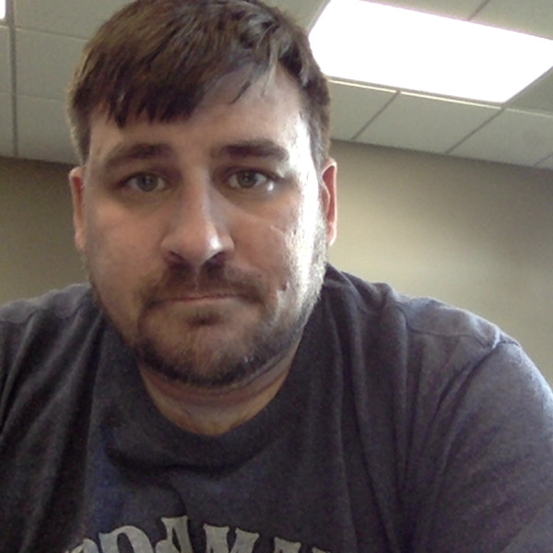
About the Developer
Michael Wilson
Mobile developer with a focus on Android
Notes:
Headshot will be added later, when we get them

